Slide 1
Unit 3
Decision making and Looping:

Slide 2
Basic Program Control
Controlling Program Execution :-
For Loop
While Loop
Do-while Loop
Nested Loops

Slide 3
What are Control Constructs ?
Performs a set of instructions repeatedly.
This involves repeating some portion of the program either a specified number of times or until a particular condition is being satisfied.

Slide 4
Why use Control Constructs ?
We frequently need to perform an action over and over, often with variations in the details each time. The mechanism which meets this need is the loop.
In a C Program, the statements are executed sequentially,
but in a number of situations, it may occur that certain decisions need to be made and some statements might be executed repeatedly.
To handle such situations, control constructs are used.

Slide 5
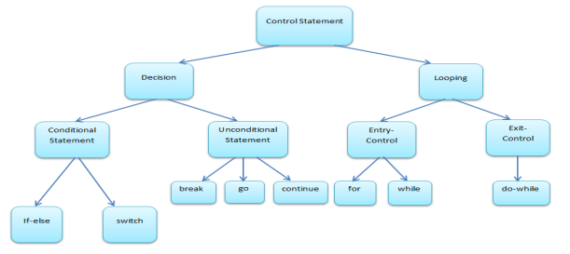

Slide 6
Types
Sequence Control
Decision Control
if( ) else
else if( )
Case Control
switch( )
Repetition
for( )
while( )
do while( );
Conditional Statements
Loops

Slide 7
Diagram
Sequence
Selection
Repetition
no
yes
no
yes

Slide 8
C goto Statement
The goto statement is used to alter the normal sequence of a C program.

Slide 9
Syntax of goto statement
The goto statement is used to alter the normal sequence of a C program.
goto label;
... .. ...
... .. ...
label:
statement;

Slide 10
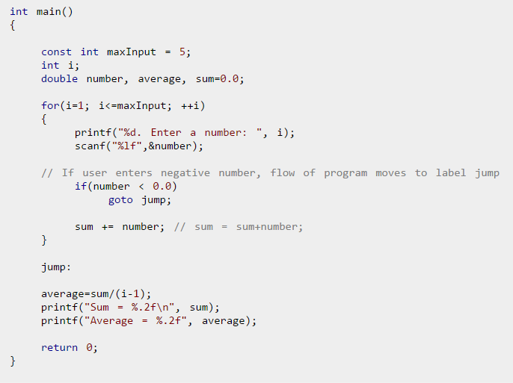
Example Of Program Using GOTO statement

Slide 11
If_Else Conditional Statement
Evaluates an expression & depending on whether the value is True or False certain group of statements are executed.
Logical & Relational Operators are used.
Syntax
if (condition is true)
statement 1;
else
statement 2;

Slide 12
Syntax : If
if(expression)
statement; //single statement executed
//if expression is true
if(expression)
{ //statements inside { } are //executed if expression is true
statement1;
statement2;
…
statement n;
}

Slide 13
Syntax : If else
if(expression)
statement;
else
statement;
if(expression)
{
statement block
}
else
{
statement block
}

Slide 14
Example (1) : If Else
Enter your guess number : 7
Right Guess
void main( )
{
int magic=7, num;
printf(“Enter your guess number : “);
scanf(“%d”,&num);
if (num = = magic)
printf(“Right Guess”);
else
printf(“Wrong Guess”);
}

Slide 15
Example (2) : If Else
void main( )
{
int num;
printf(“Enter a number : “);
scanf(“%d”,&num);
if (num<10)
printf(“Less than 10”);
else
printf(“Greater than 10”);
}
Enter a number : 11
Greater than 10
Enter a number : 10
Greater than 10

Slide 16
Example (3) : If
#include <stdio.h>
void main( )
{ int flag = 0;
if( ! flag )
{
printf("The flag is not set.\n");
flag = ! flag;
}
printf("The value of flag is now %d\n", flag);
}
The flag is not set.
The value of flag is 1

Slide 17
Else If
Used in a situation in which one of several different courses of action will be selected.
If none of the conditions are true then the last else part will be executed. It can be used to provide a default condition or an error message.

Slide 18
Else If
if(expression)
statement;
else if (expression)
statement;
else
statement;
if(expression)
{
statement block
}
else if (expression)
{
statement block
}
else
{
statement block
}

Slide 19
Example (1) : Else If
void main( )
{ int score;
printf(“Enter Score : “);
scanf(“%d”,&score);
if ((score>=75)&&(score<=100))
printf(“Distinction”);
else if ((score>=60) && (score<75))
printf(“First Class”);
else if ((score>=50)&&(score<60))
printf(“Second Class”);
else
printf(“Fail”);
}
Enter Score : 75
Distinction
Enter Score : 101
Fail

Slide 20
Example (2) : Else If
void main( )
{ int score;
printf(“Enter Score : “);
scanf(“%d”,&score);
if ((score <=100) | | (score>0))
{ if (score>=75)
printf(“Distinction”);
else if ((score>=60) && (score<75))
printf(“First Class”);
else if ((score>=50)&&(score<60))
printf(“Second Class”);
else
printf(“Fail”);
}
else printf(“Wrong marks entered”);
}
Enter Score : 101
Wrong marks entered

Slide 21
Comparison of ?: and if-else
Conditional Operator is similar to if-else with only one limitation i.e. only one C statement can follow the ? and : , hence for serious C programming if-else is used instead of ternary operator.
(x>y ? (max=x) : (max=y)); | if(x>y) max=x; else max=y;
(num<0 ? printf(“Negative\n”) : (code= =0 ? printf(“Zero\n”) : printf(“Positive\n”) ) ); | if(num<0) printf(“Negative\n”); else if(num= =0) printf(“Zero\n”); else printf(“Positive\n”);

Slide 22
Errors to be avoided in if-else
if( ) ;
printf( );
else
printf( );
if(code= =1 & flag= =0)
if(i= =5) && (j= =10) // complete condition in brackets
if(i = 5)
if( )
printf( );
else ;
printf( );

Slide 23
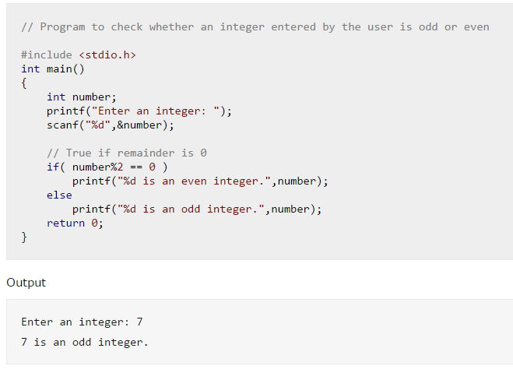
Example : Program to check whether an integer entered by the user is odd or even

Slide 24
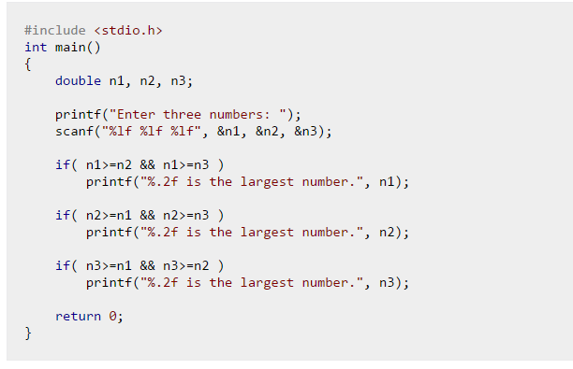
Program to find the largest number using if statement

Slide 25
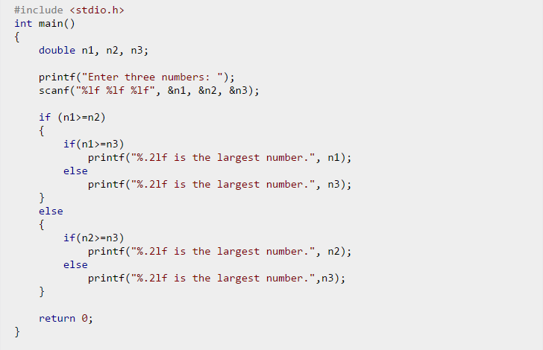
Program to find the largest number using if...else statement

Slide 26
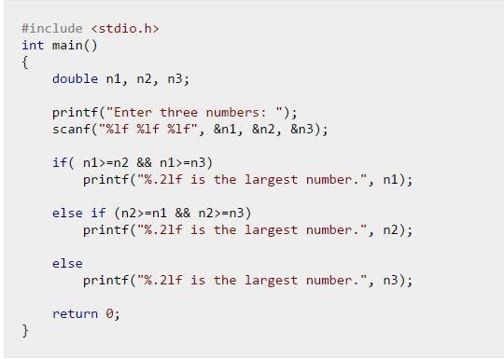
Program to find the largest number using nested if...else statement

Slide 27
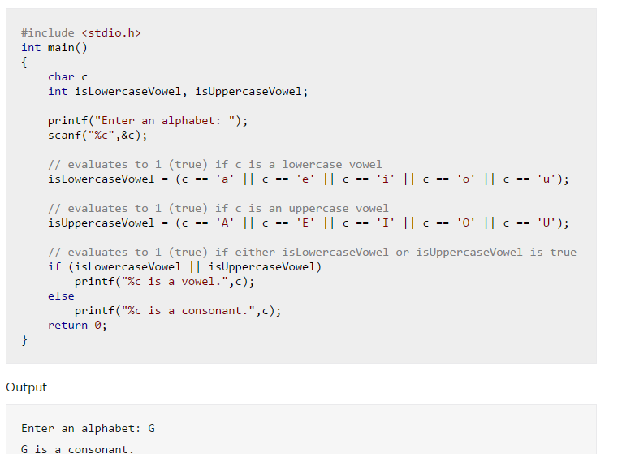
Program to Check Vowel or consonant

Slide 28
Switch
Similar to nested if-else statements that test for equality. Causes a particular group of statements to be chosen from several available groups. The selection is based on the current value of the expression in switch statement.
Syntax :
switch(expression)
{ case expression1 :
…………
break;
case expression2 :
…………
break;
default :
…………
}

Slide 29
Switch-Case
If no match is found with any of the case statements, only the statement following the default are executed.
Once a case is satisfied the control simply falls through the case till it does not encounter a break statement.
We Cannot give condition in switch.
Only int or char in switch.
Float not allowed.
If you want that only one case be executed, so give a break statement after that case.

Slide 30
Example (1) : Switch
Enter a number 1-3 : 2
TWO
void main( )
{ int num;
printf(“Enter a number 1-3 : “);
scanf(“%d”,&num);
switch(num)
{
case 1 : printf(“ONE\n”); break;
case 2 : printf(“TWO\n”); break;
case 3 : printf(“THREE\n”); break;
default : printf(“Wrong Input\n”);
}
Enter a number 1-3 : 4
Wrong Input

Slide 31
Example (2) : Switch
void main( )
{ char letter;
printf(“Enter a letter r,g,b : “);
scanf(“%c”,&letter);
switch(letter)
{
case ‘r’ : case ‘R’: printf(“RED\n”); break;
case ‘g’ : case ‘G’: printf(“GREEN\n”); break;
case ‘b’ : case ‘B’: printf(“BLUE\n”); break;
default : printf(“Wrong Input\n”);
}
Enter a letter r,g,b : b
BLUE

Slide 32
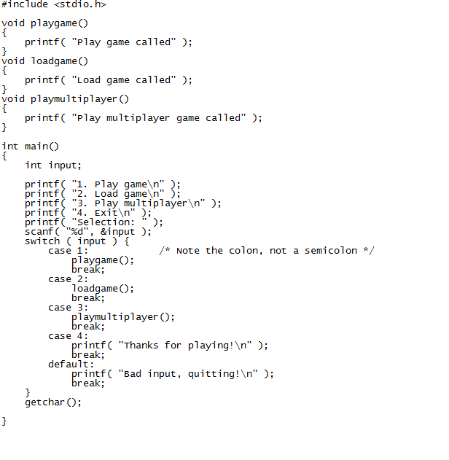

Slide 33
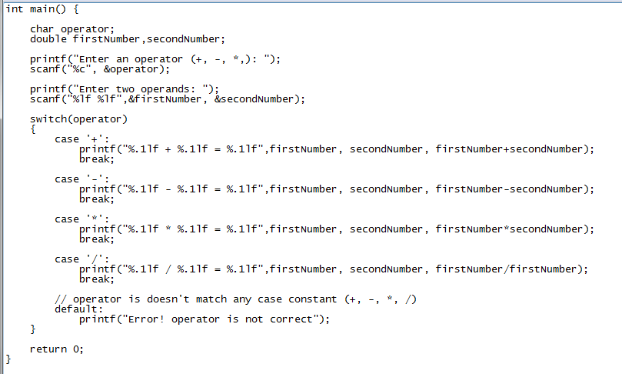
Program to create a simple calculator Performs addition, subtraction, multiplication or division depending the input from user

Slide 34
Errors to be avoided in switch
If a case is not ended with a break. The control will flow through the case & the case following it until a break is encountered.
Do not enclose multiple statements of each case in brace as each case is bounded by the case & the break. Curly brace only encloses the switch statement.
Break when used in switch takes control outside the switch. However continue will not take the control to the beginning of switch.

Slide 35
While loop
While contains a condition.
As long as the condition remains true all statements within the body of the while loop keep get executed repeatedly.
A loop counter or an index variable is incremented or decremented with respect to the condition.
As a rule the while must test a condition that will eventually become false, otherwise the loop would be executed forever, indefinitely.

Slide 36
While loop Syntax
Syntax :
while (condition)
{ group of
statements
}

Slide 37
While loop
while (condition)
statement;
while (condition)
{
statement block
}
no
yes

Slide 38
Example : while
void main( )
{
int num=1;
while(num<6)
{
printf(“%d\n”,num);
num=num+1;
}
}
Initialisation before while
1
2
3
4
5
Initialisation before while
Loop condition
Loop variable increment

Slide 39
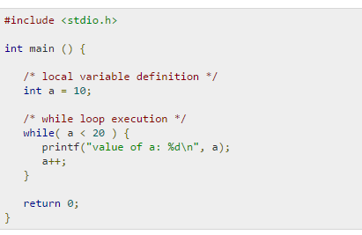
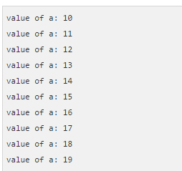
Example while loop

Slide 40
Reverse of a number
#include <stdio.h>
int main() {
int n, reverse = 0, remainder;
printf("Enter an integer: ");
scanf("%d", &n);
while (n != 0) {
remainder = n % 10;
reverse = reverse * 10 + remainder;
n /= 10;
}
printf("Reversed number = %d", reverse);
return 0;
}
Output
Enter an integer: 2345
Reversed number = 5432

Slide 41
#include <stdio.h>
int main() {
int n, i, sum = 0;
printf("Enter a positive integer: ");
scanf("%d", &n);
i = 1;
while (i <= n) {
sum += i;
++i;
}
printf("Sum = %d", sum);
return 0;
}

Slide 42
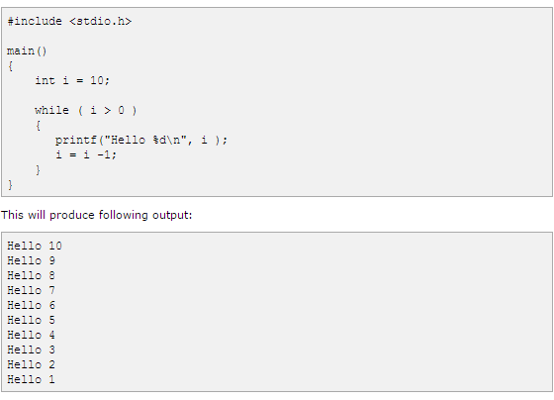
Example While Loop

Slide 43
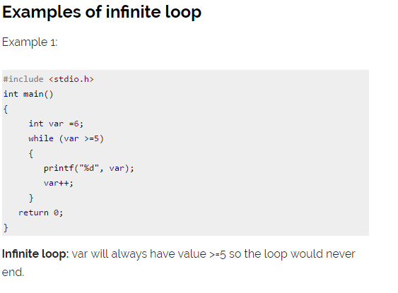

Slide 44
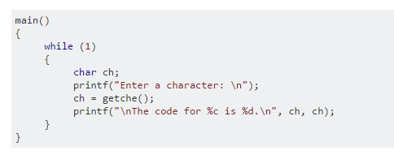
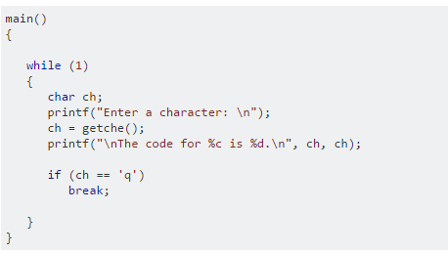
Infinite Loop

Slide 45
The do/while statement
do
statement;
while (condition);
do
{
statement block
} while (condition);
yes
no

Slide 46
While vs Do-While
Condition tested before executing any of the statements within the while loop. | Condition tested after having executed the statements within the do-while loop.
Will not execute the statements of the condition fails for the first time. | Executes its statements at least once even if the condition fails for the first time itself.
void main( ) { while(4<1) printf(“Hello Here\n”); } | void main( ) { do printf(“Hello Here\n”); while(4<1); }

Slide 47
C Program to print multiplication table using do...while loop
#include <stdio.h>
int main()
{
int N = 5, i = 1;
do {
printf("%d\tx\t%d\t=\t%d\n", N, i, N * i);
} while (i++ < 10);
return 0;
}

Slide 48
Difference between while and do…while Loop in C
while Loop | do…while Loop
The test condition is checked before the loop body is executed. | The test condition is checked after executing the body.
When the condition is false, the body is not executed not even once. | The body of the do…while loop is executed at least once even when the condition is false.
It is a type of pre-tested or entry-controlled loop. | It is a type of post-tested or exit-controlled loop.
Semicolon is not required. | Semicolon is required at the end.

Slide 49
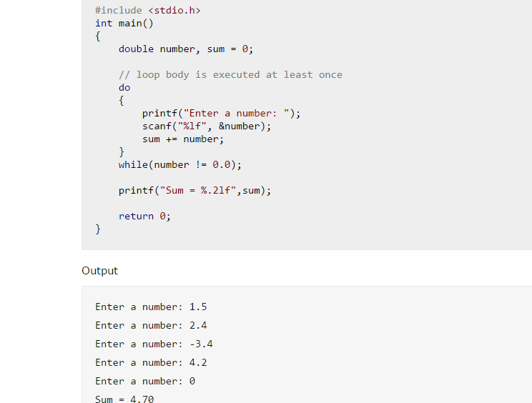
Do While : Program to add numbers until user enters zero

Slide 50
For Loop
A for loop is a repetition control structure that allows you to efficiently write a loop that needs to execute a specific number of times.
Syntax :
for ( init; condition; increment )
{
statement(s);
}

Slide 51
Syntax Explanation
The init step is executed first, and only once. This step allows you to declare and initialize any loop control variables. You are not required to put a statement here, as long as a semicolon appears.
Next, the condition is evaluated. If it is true, the body of the loop is executed. If it is false, the body of the loop does not execute and the flow of control jumps to the next statement just after the 'for' loop.
After the body of the 'for' loop executes, the flow of control jumps back up to the increment statement. This statement allows you to update any loop control variables. This statement can be left blank, as long as a semicolon appears after the condition.
The condition is now evaluated again. If it is true, the loop executes and the process repeats itself (body of loop, then increment step, and then again condition). After the condition becomes false, the 'for' loop terminates.

Slide 52
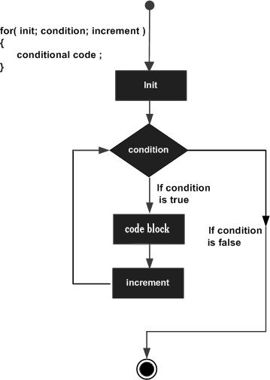
The for statement

Slide 53
Example : for loop
void main( )
{
int num;
for(num=1;num<=5;num++)
printf(“%d\n”,num);
}
1
2
3
4
5
Initialisation
Loop condition
Loop index incremented

Slide 54
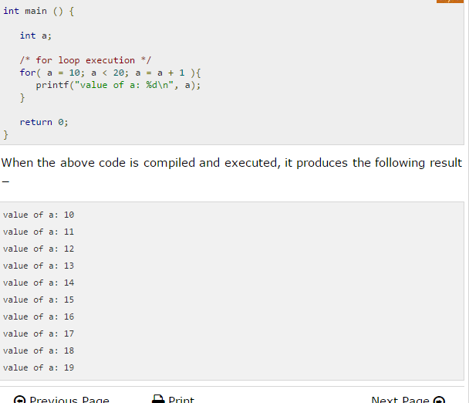
Example for loop

Slide 55
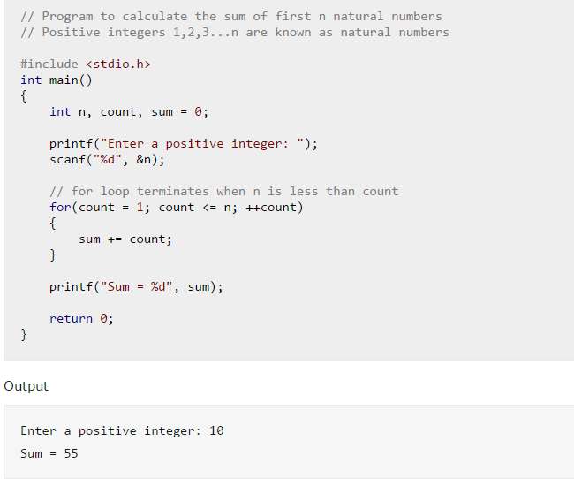
For loop example

Slide 56
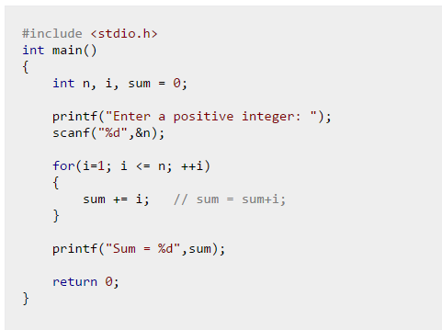
Sum of Natural Numbers Using for Loop

Slide 57
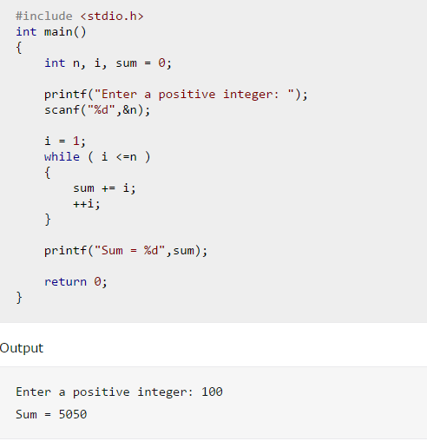
Sum of Natural Numbers Using while Loop

Slide 58
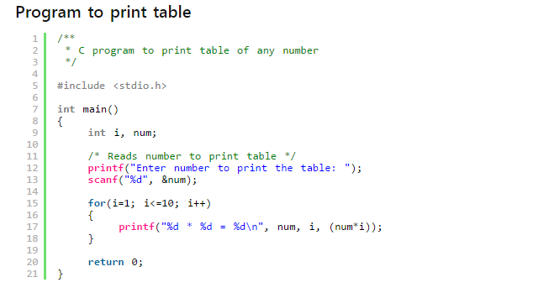
C program to print table of any number

Slide 59
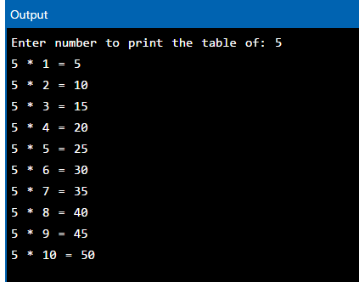
Output :C program to print table of any number

Slide 60
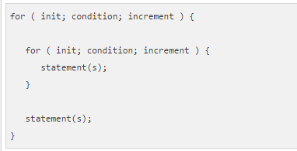
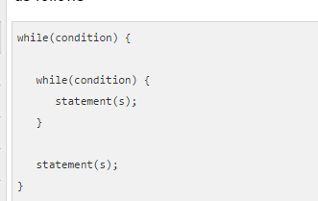
nested loops in C
C programming allows to use one loop inside another loop.

Slide 61
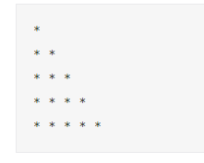
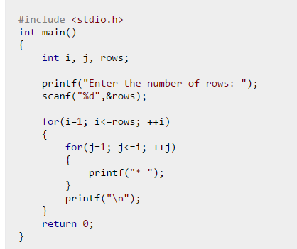
Example 1: Program to print half pyramid using *

Slide 62
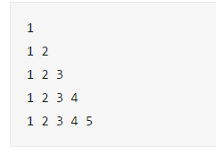
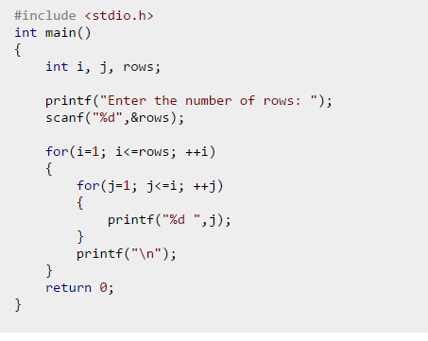
Example 2: Program to print half pyramid a using numbers

Slide 63
Break Statement
To jump out of the loop instantly, without waiting to get back to the conditional test.
Exits from the immediate loop only.
Control automatically passes to the first statement after the loop.
Break in do-while, while or for : takes out of the loop bypassing the conditional test.
Break in switch : takes out of the switch.

Slide 64
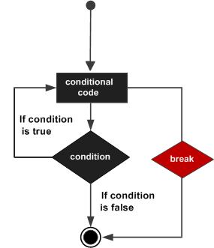
Flow Diagram for break

Slide 65
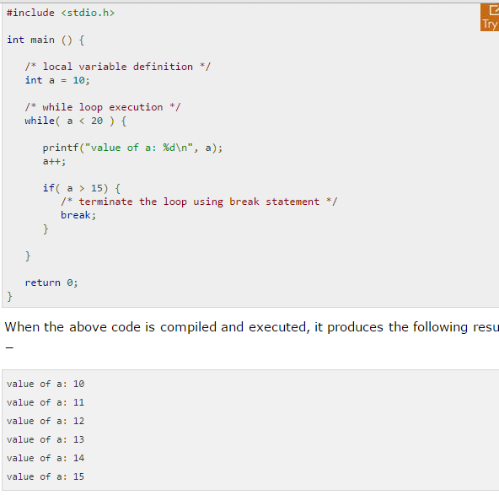
Example using break

Slide 66
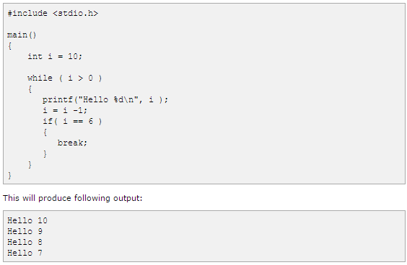
Example using break

Slide 67
Continue Statement
The remaining loop statements are skipped and the execution proceeds directly to the next pass through the loop.
Can be included within a while, do-while or for.
Continue in while or for : Control automatically passes to the beginning of the loop.
Continue in do-while : Sends the control straight to the test at the end of the loop.

Slide 68
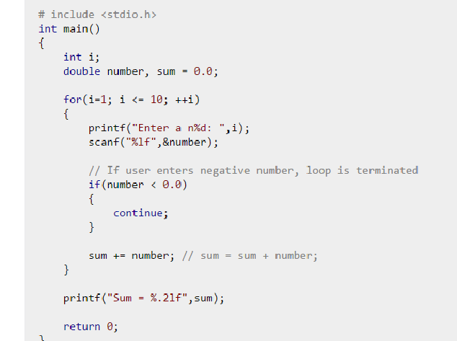
Program to calculate sum of maximum of 10 numbers ,Negative numbers are skipped from calculation

Slide 69
Thank You

